Slide 1
CHAPTER 3 Well posed predictive control 3 Long output horizons
Anthony Rossiter

Slide 2
Introduction
The previous video demonstrated, through examples and simple argument, that the use of short output horizons is likely to lead to poorly defined optimisations, that is optimisations which do not in fact imply optimal behaviour in any reasonable sense.
This video investigates the contrary position of using rather large output horizons, within GPC.
In this case the choice of input horizon is significant as will be shown.
We begin with some MATLAB examples.
Reminder that we are assuming no feedforward information for now.

Slide 3
Long output horizons, nu=1
Predictions look OK. Seems to give open loop behaviour.
Changing weight has minimal impact – useless parameter?
Predicted
steady-state error goes down as horizon increases.
gpc3_3_example1.m

Slide 4
Long output horizons, nu=2
Increasing the input horizon has a small impact on long term predictions.
HOWEVER, CAREFUL INSPECTION WILL SHOW A VERY DIFFERENT CHOICE FOR THE FIRST INPUT WHICH RESULTS IN QUITE DIFFERENT CLOSED-LOOP BEHAVIOUR.

Slide 5
Open-loop prediction vs closed-loop
The actual closed-loop behaviour is similar to the open-loop within the horizon.
This suggests the optimisation is well-posed.
Closed-loop behaviour is more likely to be due to good design.
Also close to open-loop dynamics

Slide 6
Long output horizons example 2
NMP and simple real poles, but one is quite slow.
Overall prediction strategy is quite slow!
As horizon increases, predictions move closer to desired steady-state.
gpc3_3_example2.m

Slide 7
Open-loop prediction vs closed-loop
The actual closed-loop behaviour is similar to the open-loop within the horizon, and more similar as ny increases.
This suggests the optimisation is well-posed.
Closed-loop behaviour is more likely to be due to good design.
NOTE: Also close to open-loop dynamics,

Slide 8
Long output horizons example 3
Simple real poles, but one unstable.
Overall prediction strategy is quite poor because with nu=1, prediction must be divergent!
In this case, even if the control law was stabilising, it is clear that the ‘optimum’ control strategy is nonsense given it is based on a divergent prediction!
gpc3_3_example3.m

Slide 9
Long output horizons example 3
Simple real poles, but one unstable.
Increase nu to 2 and one gets a notable different conclusion.
Now the prediction class is ‘good’ within the horizon, even though small rounding errors cause divergence in the long term (feedback would correct this).
gpc3_3_example3.m

Slide 10
Long output horizons example 3
Simple real poles, but one unstable.
HOWEVER THINGS get worse as the horizon increases!
Due to the H, P, Q matrices been made up of divergent predictions, the numerics become unreliable for large ny.
gpc3_3_example3.m

Slide 11
Long output horizons example 4
Complex poles, but stable.
Overall prediction strategy is quite poor AS FOCUS ON SS AND NOT TRANSIENTS
Increasing nu is far more effective here!
gpc3_3_example4.m

Slide 12
Observation summary
Long output horizons reduce the steady-state error in the predictions.
This is to be expected given the performance index is summarised as:
The predictions will reach steady-state (exclude divergent predictions) after n samples and thus J will be dominated by steady-state errors if ny>>n.
If nu=1, the control will move directly to the steady-state value (or close).

Slide 13
Observations continued (large ny, nu=1)
For a stable process, the optimal control move will be close to the desired steady-state and thus the closed-loop behaviour will be very close to open-loop dynamics.
Where open-loop dynamics are good, then this will be effective – optimisation is well-posed.
If open-loop dynamics are bad, then this will be ineffective (for example oscillatory modes).
If open-loop dynamics unstable, this can be disastrous!

Slide 14
Observations continued (nu=1)
For an open-loop unstable process, a single control move results in divergent predictions.
Consequently, it is not possible to form a meaningful prediction close to the target and thus any optimisation is not well-posed.
If open-loop dynamics are unstable, the use of nu=1 can be disastrous for almost any choice of ny!
GPC stabilising this case is more by accident than design and should not be trusted.

Slide 15
Reflections
The use of long output horizons seems to make good sense and avoids any possibility of ignoring important dynamics within the performance index. With nu=1, optimised predictions match resulting closed-loop behaviour quite closely (stable systems).
If ny is large, any ignored dynamics are at steady-state (discount OL unstable as these need careful treatment).
However, the danger now is that the steady-state errors can swamp the transient errors.
Although J must consider the steady-state, we want more emphasis on the transient errors as these are the only thing affected by the current control choice.

Slide 16
Choices (nu=1)
ny is small puts the emphasis is on transients, but steady-state predictions could be poor.
Optimisation is ill-posed.
ny is large puts the emphasis is on steady-state and ignores the transients.
Optimisation does not focus on transient behaviour which is usually undesirable but could be considered well-posed otherwise.
If nu=1, for many cases GPC is not well defined.
The optimisation is either ill-posed or does not emphasise transients enough.

Slide 17
Conclusions
Demonstrated through numerous examples that for many cases, both a low output horizon and a high output horizon can be poor choices, especially if nu=1.
THE CLEAR EXCEPTION IS WHERE OPEN-LOOP DYNAMICS ARE SATISFACTORY – HENCE DMC OFTEN DEPLOYED LARGE NY AND NU=1.
With nu=1, in general, one cannot do a systematic GPC design that tackles transient behaviour.
One might wonder whether this is a fundamental weakness of GPC.
The following videos will consider the relevance of the control horizon in more detail.
With high ny and nu=1, the optimisation is well-posed in that the optimisation results are consistent with the closed-loop behaviour that results (excluding unstable systems).

Slide 18



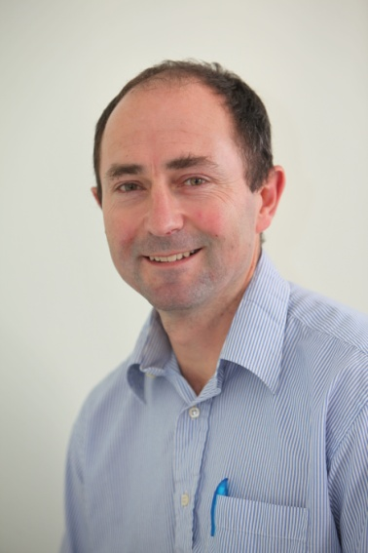
Anthony Rossiter
Department of Automatic Control and Systems Engineering
University of Sheffield
www.shef.ac.uk/acse
© 2014 University of Sheffield
This work is licensed under the Creative Commons Attribution 2.0 UK: England & Wales Licence. To view a copy of this licence, visit http://creativecommons.org/licenses/by/2.0/uk/ or send a letter to: Creative Commons, 171 Second Street, Suite 300, San Francisco, California 94105, USA.
It should be noted that some of the materials contained within this resource are subject to third party rights and any copyright notices must remain with these materials in the event of reuse or repurposing.
If there are third party images within the resource please do not remove or alter any of the copyright notices or website details shown below the image.
(Please list details of the third party rights contained within this work.
If you include your institutions logo on the cover please include reference to the fact that it is a trade mark and all copyright in that image is reserved.)

